Slide 1
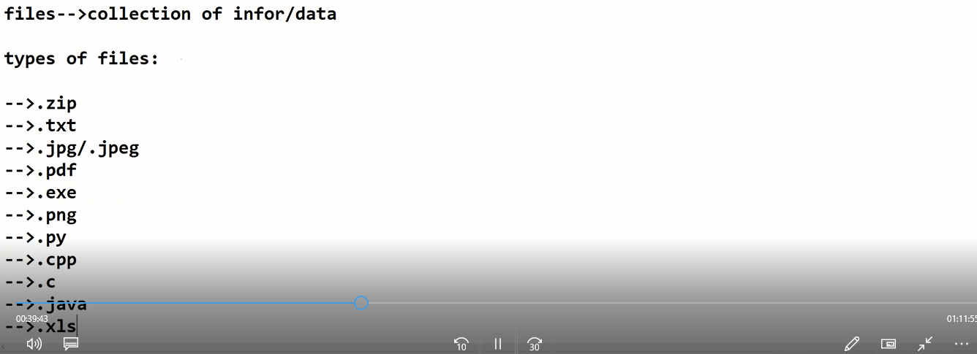

Slide 2
File handling is an important part of any web application.
Python has several functions for creating, reading, updating, and deleting files.
File Handling
The key function for working with files in Python is the open() function.
The open() function takes two parameters; filename, and mode.
There are four different methods (modes) for opening a file:
"r" - Read - Default value. Opens a file for reading, error if the file does not exist
"a" - Append - Opens a file for appending, creates the file if it does not exist
"w" - Write - Opens a file for writing, creates the file if it does not exist
"x" - Create - Creates the specified file, returns an error if the file exists

Slide 3
In addition you can specify if the file should be handled as binary or text mode
"t" - Text - Default value. Text mode
"b" - Binary - Binary mode (e.g. images)
Syntax
Variablename=open(“filelocation\\filename.extension”,”mode”)
Variablename.close()

Slide 5
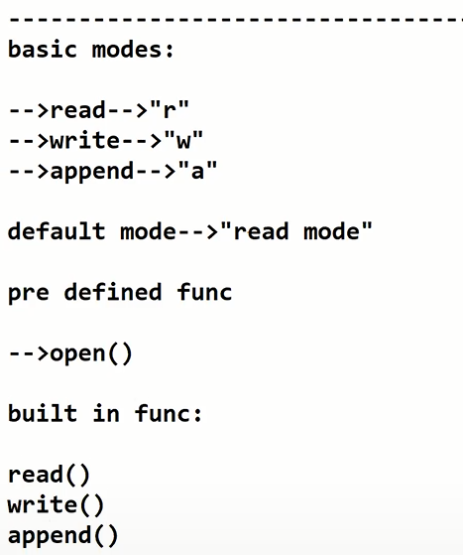

Slide 6
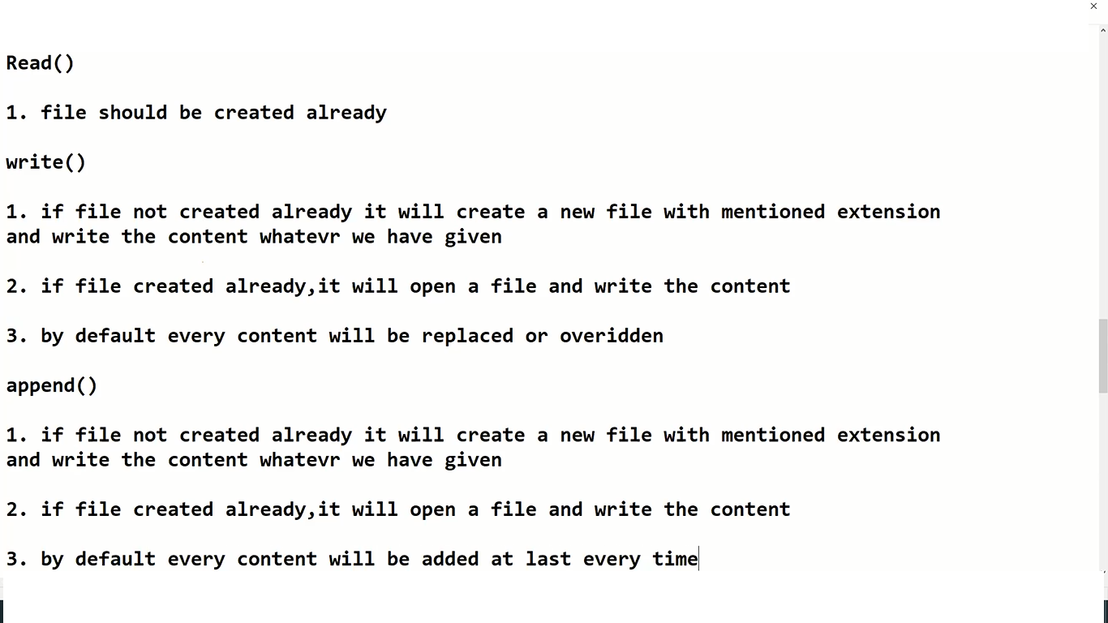

Slide 7
file handling
read
a=open('F:\\New folder\\new.txt','r')
print(a.read())
a.close()
write
a=open('F:\\New folder\\new.txt','w')
a.write("hai hgow are you all!...")
a.close()
append
a=open('F:\\New folder\\new.txt','a')
a.write("fdsdfsdf gsdfgf gdfsgd gdfgdfg gfgdfgd")
a.close()
creating a new file
a=open('F:\\New folder\\mypythonpgm.txt','x')
a.close()

Slide 8
example pgm
a=open('F:\\New folder\\mypythonpgm1.txt','x')
print("created a new file!...")
#a.close()
a=open('F:\\New folder\\mypythonpgm1.txt','a')
print("ready to input a file!.... ")
for i in range(1,3):
print("Enter the ",i," person Details!...")
name=input("Enter the Name : \n")
string="person " + str(i) + " details"
a.write(string)
a.write("\n")
a.write(name)
a.write("\n")
age=input("Enter the age : \n")
a.write(age)
a.write("\n")
add=input("Enter the Address : \n")
a.write(add)
a.write("\n")
print("Finished the input!...")
a.close()

Slide 9
delete a file
import os
os.path.exists("F:\\New folder\\new.txt"):
os.remove("F:\\New folder\\new.txt")
print("File deleted!....")
delete a file..before deleting check file is present or not
import os
if os.path.exists("F:\\New folder\\new.txt"):
os.remove("F:\\New folder\\new.txt")
print("File deleted!....")
else:
print("File doesnt present!....")

Slide 10
Write a Python program to read first n lines of a file.
Write a Python program to read a file line by line store it into a variable
Write a Python program to get the file size of a file.
Write a python program to get number of line in file

Slide 11
Write a Python program to get the file size of a plain file.
def file_size(fname):
import os
statinfo = os.stat(fname)
return statinfo.st_size
print("File size in bytes of a plain file: ",file_size("test.txt"))
Write a Python program to read a file line by line and store it into a list.
def file_read(fname):
with open(fname) as f:
#Content_list is the list that contains the read lines.
content_list = f.readlines()
print(content_list)
file_read(\'test.txt\')

Slide 12
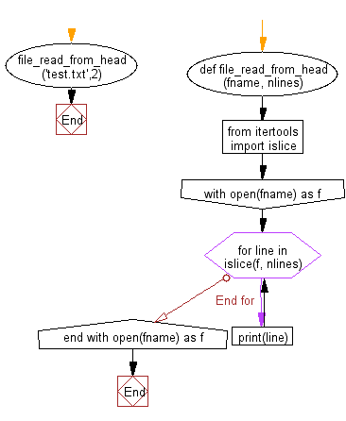
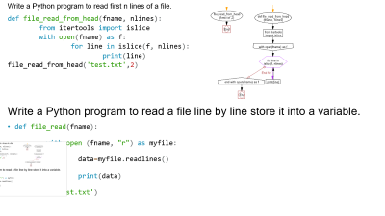
Write a Python program to read first n lines of a file.
def file_read_from_head(fname, nlines):
from itertools import islice
with open(fname) as f:
for line in islice(f, nlines):
print(line)
file_read_from_head('test.txt',2)
Write a Python program to read a file line by line store it into a variable.
def file_read(fname):
with open (fname, "r") as myfile:
data=myfile.readlines()
print(data)
file_read('test.txt')

Slide 13
Writ e a Python program to count the number of lines in a text file.
Reading a specific line from a File
line_number = 4
fo = open(“C:/Documents/Python/test.txt”, ’r’)
currentline = 1
for line in fo:
if(currentline == line_number):
print(line)
break
currentline = currentline +1
count=0
a=open('C:\\Users\\Livewire\\Desktop\\kiwi.java','r')
for i in a:
count=count+1
print(count)

Slide 14
Binary mode
'''f = open('C:\\Users\\Manoj\\Desktop\\sample2.bin', 'rb')
print(f.read())
f.close()'''
'''f = open('C:\\Users\\Manoj\\Desktop\\sample2.bin', 'wb')
print(f.write(b"xc3\x8a\xc3\xbe"))
f.close()'''
f = open("C:\\Users\\Manoj\\Desktop\\mypic.png", 'rb')
print(f.read())
f.close()

